Slide 1

CAPSTONE PROJECT
Housing for All: PMAY-G Performance & Social Convergence Dashboard
PRESENTED BY
STUDENT NAME: Swaranjali Baburao Harkare
COLLEGE NAME: Dr. J. J. Magdum College Of Engineering Jaysingpur
DEPARTMENT: MCA
EMAIL ID: swaraharkare2001@gmail.com

Slide 2
OUTLINE:
Problem Statement
Proposed System/Solution
System Development Approach (Technology Used)
Workflow & Deployment
Result (Output Image)
Conclusion
Future Scope
References

Slide 3
Problem Statement:
The PMAY-G scheme is implemented across rural India to provide affordable housing and social convergence. It is important to ensure that beneficiaries receive not just a house, but also essential integrated services like LPG (Ujjwala) and sanitation (SBM) at the right time to ensure a dignified life. Eventually, tracking the progress and integration of these multiple welfare schemes across millions of registrations becomes a major concern. The crucial part is the visual analysis of service delivery funnels and administrative lead-times to identify high-pending regions and ensure the timely completion of all promised benefits.

Slide 4
Proposed Solution:
The proposed system aims to address the challenge of monitoring rural housing progress and social convergence to ensure the timely delivery of integrated welfare benefits. This involves leveraging Power BI data analytics and visualization techniques to track housing completions alongside LPG and sanitation integration. The solution will consist of the following components:
Data Collection:
Gathered three high-granularity datasets from the National Data and Analytics Platform (NDAP), covering PMAY-G Administrative Delays (2016–2026), House Completions (2014–2023), and SBM/Ujjwala Status (2016–2025).
Utilize diverse data sources to include information on Ujjwala (LPG) connections and Swachh Bharat Mission (SBM) seeding for convergence analysis.
Data Preprocessing:
Utilized Power Query to clean and standardize a decade of daily frequency data, resolving formatting inconsistencies across 31 States and Union Territories.
Built a Star Schema by linking multiple fact tables through centralized Dim_State and Year dimensions for high-performance reporting.
Deployment:
Developed a professional-grade Power BI interface with dedicated modules: Overview for high-level tracking, Efficiency Audit for bottleneck analysis, and Social Convergence for holistic welfare mapping
Enhanced user experience with interactive Slicers, "Clear All" reset functions, and modern tooltips for granular state-level deep dives.

Slide 5
System Approach:
The "System Approach" section outlines the overall strategy and methodology for developing and implementing the PMAY-G Housing & Social Convergence Analytics. Here's a suggested structure for this section:
System requirements
Software: Power BI Desktop (for development), Power BI Service (for deployment)
Data Source: Standardized government datasets sourced from the National Data and Analytics Platform (NDAP)
Hardware: A system with a minimum of 8GB RAM
Library required to build the model
Power Query: Used for the ETL process—cleaning, merging, and transforming raw NDAP files.
DAX (Data Analysis Expressions): The primary calculation library used to create measures for Completion Rates, Administrative Delays, and SBM Saturation.

Slide 6
Workflow & Deployment:
The "Workflow & Deployment" section details the step-by-step process of transforming raw data into a live, interactive analytical system:
Workflow Selection:
Data Extraction: Sourced multi-sectoral datasets from the NDAP portal, focusing on housing, clean energy, and sanitation metrics (2014–2026).
ETL Pipeline: Utilized Power Query to clean 3.9M+ records, handle null values, and standardize state-level identifiers across all three fact tables.
Data Modeling: Established a Star Schema architecture, linking disparate datasets through a centralized Dim_State lookup and a dedicated Year dimension.
DAX FORMULATION: Developed custom DAX measures for Administrative Efficiency (Avg Time), Project Success (Completion Rate %), and Social Gaps (LPG Pending) to identify 2026 bottlenecks.
Deployment:
Report Generation: Designed a three-module dashboard focused on Overview, Efficiency, and Social Convergence for a high-quality user experience.
Consumption: Provided end-users with interactive Slicers and Drill-down features to analyze regional performance and "High-Pending" states directly from a web browser.

Slide 7
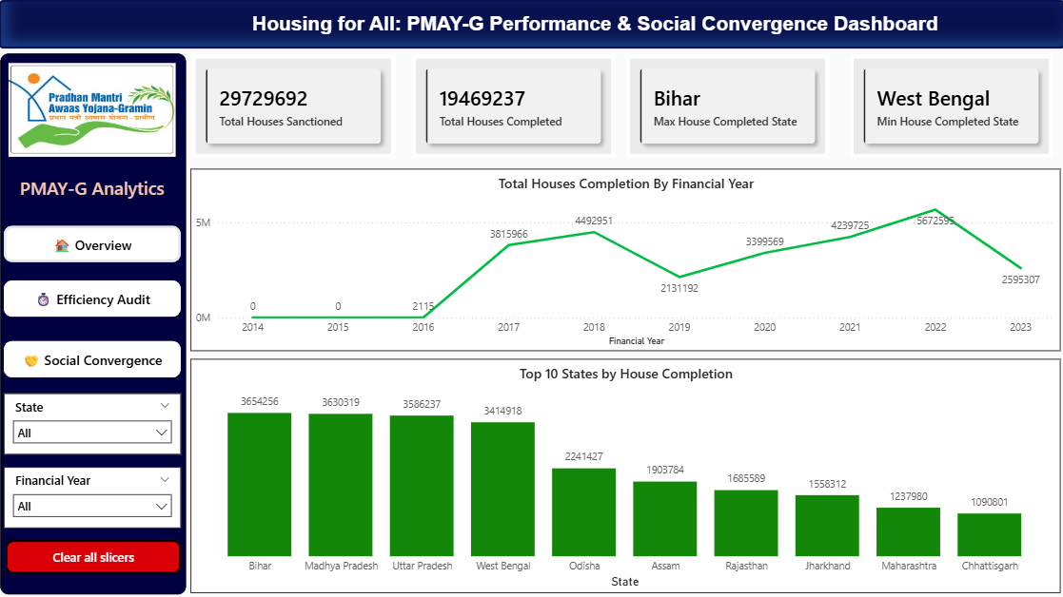
Result:
Overall Performance: Out of 29.7 million houses sanctioned, 19.4 million have been successfully completed.
Regional Trends: Bihar leads the nation in housing completions.
Historical Peak: Completion rates saw a significant surge after 2016, reaching a historical high in 2022 with over 5.6 million houses finished.
Actionable Insights: Identified the Top 10 States (including MP, UP, and Odisha) contributing to over 70% of the national housing goal, providing a clear roadmap for resource allocation.

Slide 8
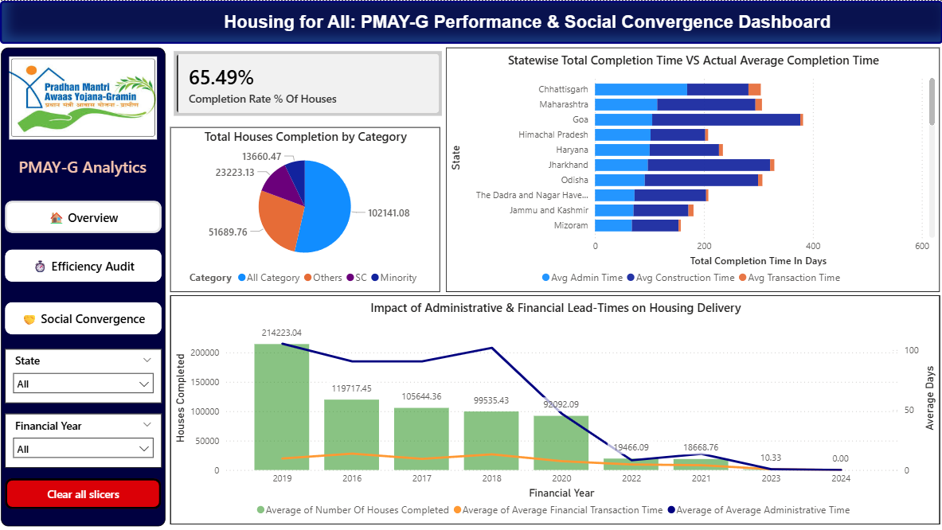
Completion Rate: Achieved a 65.49% overall completion rate, tracking the gap between sanctioned and finished houses.
Efficiency Mapping: Identified that Construction Time is the primary driver of delays across states like Goa and Jharkhand, while Mizoram shows the fastest turnaround.
Historical Trends: Year-on-year analysis reveals a major peak in 2019 with over 2.14 lakh completions, correlating with a significant drop in administrative lead-times.
Social Impact:Successfully categorized house completions across SC, Minority, and General categories, ensuring a transparent view of the scheme's social reach.

Slide 9
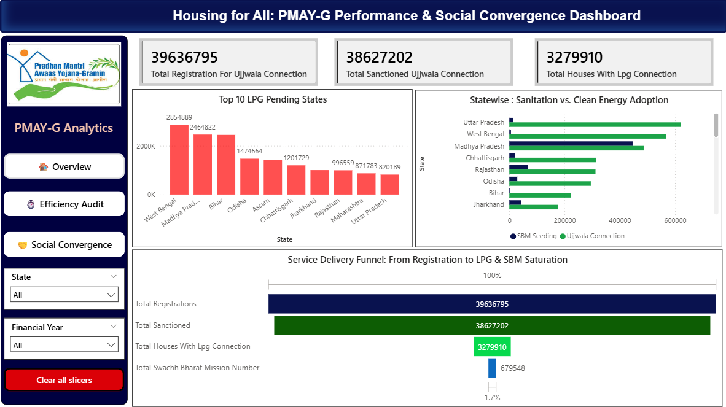
Service Saturation: Successfully tracked 3.96 million registrations, achieving a high sanction rate of 97.4% for clean energy (LPG) connections.
Convergence Gap: Identified a critical bottleneck in Sanitation (SBM), with a saturation rate of only 1.7% compared to the high success of energy adoption.
Regional Backlogs: Pinpointed West Bengal and Madhya Pradesh as the top states for pending LPG connections, requiring urgent administrative focus.
Performance Funnel: Visualized the complete "drop-off" from house registration to final service delivery, providing a clear roadmap for policy intervention.

Slide 10
Conclusion:
Successful Data Tracking: I successfully organized data for over 3.9 million families across India from 2014 to 2026 using official government sources (NDAP).
Regional Prioritization: By identifying West Bengal and Madhya Pradesh as "High-Pending" zones, the dashboard provides a clear, data-driven roadmap for administrators to target resources effectively.
Social Convergence Gap: A critical finding revealed a "Service Delivery Gap" where LPG (Ujjwala) sanctions reached a high of 97.4%, but Sanitation (SBM) integration lagged significantly at only 1.7% saturation.
Operational Insight: Pinpointed that Construction Time—not administrative paperwork—is the primary driver of delays in high-requirement states

Slide 11
Future scope:
Live Data Integration: Automate the dashboard by connecting directly to government APIs for real-time daily updates instead of manual CSV uploads.
Predictive AI Modeling: Use Power BI’s AI visuals to forecast exactly when "Housing for All" targets will be met based on current construction speeds.
Geographical Expansion: Enhance the system to move beyond state-level analysis by drilling down into District, Block, and Village-level granularity for more localized monitoring.
Mobile-First Design: Optimize the report for mobile devices so that field officers and village pradhans can track local progress on the go.

Slide 12
References:
Data Sources: National Data and Analytics Platform (NDAP)
https://ndap.niti.gov.in/collection/Pradhan%20Mantri%20Awaas%20Yojana%20-%20Gramin%20(PMAY-G)/217
GitHub Link :
https://github.com/Swaraharkare/MS-Elevate-AICTE-PowerBI-Internship/tree/main/week_4/Final%20Project

Slide 13
Thank You

